Slide 1
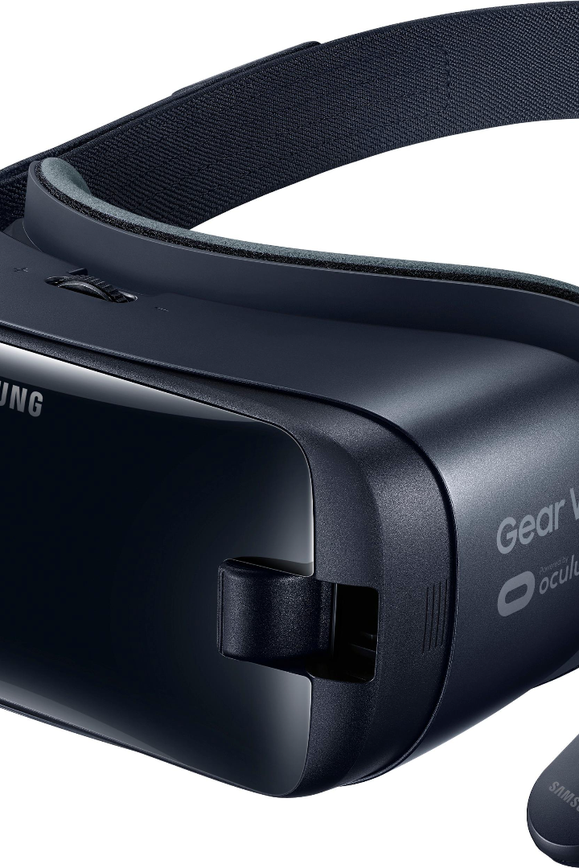
VR in Engineering: Revolutionizing the Future
Discover how Virtual Reality is transforming the field of engineering, revolutionizing design processes and enhancing collaboration. Get ready to dive into an immersive world of possibilities.

Slide 2

Benefits of VR in Engineering
1
Enhanced Visualization 🌍
2
Efficient Prototyping 💡
VR enables engineers to visualize and interact with 3D models, improving design accuracy and reducing errors.
With VR, engineers can virtually test and refine prototypes before physically building them, saving time and resources.
3
Improved Safety 🚧
By simulating hazardous scenarios, VR allows engineers to identify potential risks and develop safer solutions.

Slide 3

What is Virtual Reality?
What is Virtual Reality?
Virtual Reality (VR) is a technology that simulates a realistic and immersive experience through computer-generated environments. It creates a virtual world that users can interact with using specialized devices, such as headsets and controllers.
Virtual Reality (VR) is a technology that simulates a realistic and immersive experience through computer-generated environments. It creates a virtual world that users can interact with using specialized devices, such as headsets and controllers.
Benefits of Virtual Reality
Benefits of Virtual Reality
Enhanced immersion and engagement
Enhanced immersion and engagement
Improved learning and training experiences
Improved learning and training experiences
Opportunities for remote collaboration
Opportunities for remote collaboration
Effective visualization and simulation
Effective visualization and simulation
Entertainment and gaming experiences like never before
Entertainment and gaming experiences like never before
Applications of Virtual Reality
Applications of Virtual Reality
Gaming and entertainment
Gaming and entertainment
Educational and training simulations
Educational and training simulations
Healthcare and therapy
Healthcare and therapy
Architecture and design visualization
Architecture and design visualization
Virtual tours and travel experiences
Virtual tours and travel experiences

Slide 4
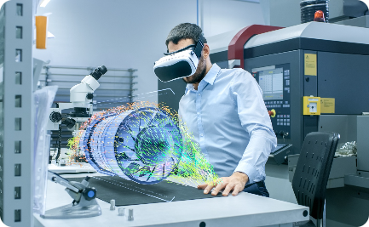
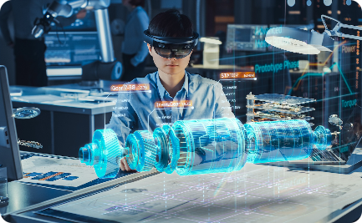
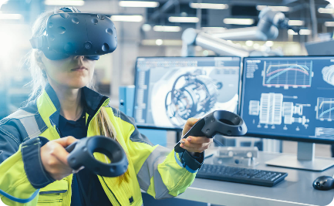
Applications of VR in Engineering
Architectural Design
Manufacturing Simulation
Aircraft Design
VR transforms the way architectural designs are visualized, helping architects and clients to better understand spatial relationships.
VR allows aerospace engineers to virtually test and evaluate aerodynamics, improving aircraft performance and fuel efficiency.
VR enables engineers to simulate assembly lines, identify bottlenecks, and optimize production processes.

Slide 5

Challenges and Limitations of VR in Engineering
Cost and Accessibility 💰
User Experience 👓
Data Integration 📊
Creating intuitive and user-friendly VR interfaces poses a challenge for engineers and designers.
Integrating VR into existing engineering workflows requires seamless data transfer and compatibility.
High-end VR equipment can be expensive, limiting accessibility and adoption for some engineering teams.

Slide 6

Case Studies of Successful VR Implementation in Engineering
1
Automotive Design
Using VR, automotive companies have reduced the time required to develop new car models by up to 40%.
2
Construction Planning
VR has revolutionized construction project planning, allowing builders to visualize layouts and identify potential clashes before construction begins.
3
Oil and Gas Exploration
Engineers in the oil and gas industry are using VR to virtually explore and plan drilling operations, reducing costs and minimizing environmental impact.

Slide 7

Future Trends and Innovations in VR for Engineering
1
Real-Time Collaboration 👥
2
Artificial Intelligence Integration 🤖
3
Haptic Feedback Technology 🖐️
Engineers will soon be able to collaborate remotely in virtual environments, transcending geographical boundaries.
Advancements in haptic feedback will allow engineers to feel and manipulate objects in VR, enhancing the design and testing process.
VR combined with AI will enable engineers to create intelligent virtual simulations, optimizing designs and performance.

Slide 8
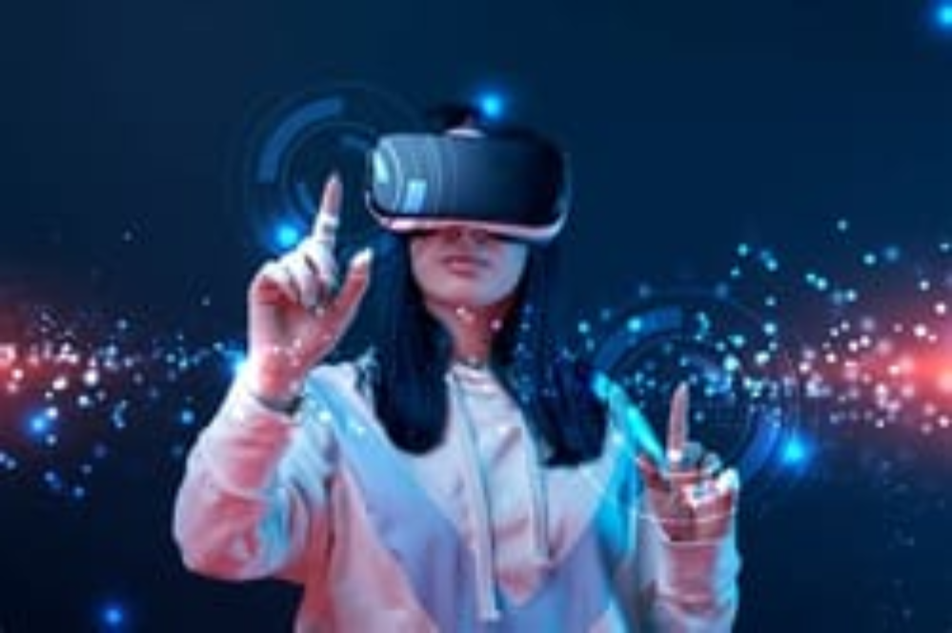
Conclusion
Virtual Reality is like a superpower for engineers! With its incredible tools, engineers can visualize, test, and iterate their designs in ways never before possible. It's revolutionizing the way we build and creating unlimited possibilities. So, put on your VR headset and embrace the future of engineering!

